Slide 1


PROJECT PRESENTATION
PATTERN RECOGNITION SESSIONAL
CSE-444
Group: B3
202114041 - Mayesha Tasnim
202114073 - Naima Jahan
202114081 - S. M. Nafis Ahmed
202114089 - Sejuty Das

Slide 2
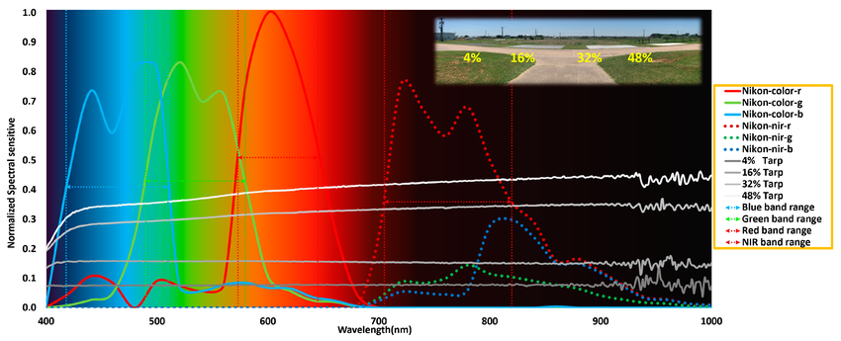
MULTI-SPECTRAL RGB-NIR SCENE DATASET CLASSIFICATION USING DEEP LEARNING MODELS

Slide 3
OUTLINE
01
Introduction
06
Proposed Dual Channel CNN
02
Literature Review
07
List of Models
03
Dataset Preprocessing
08
List of Performance Metrics
04
Project Pipeline
09
Output Analysis
05
Channel Correlation
10
Comparison Analysis
02

Slide 4
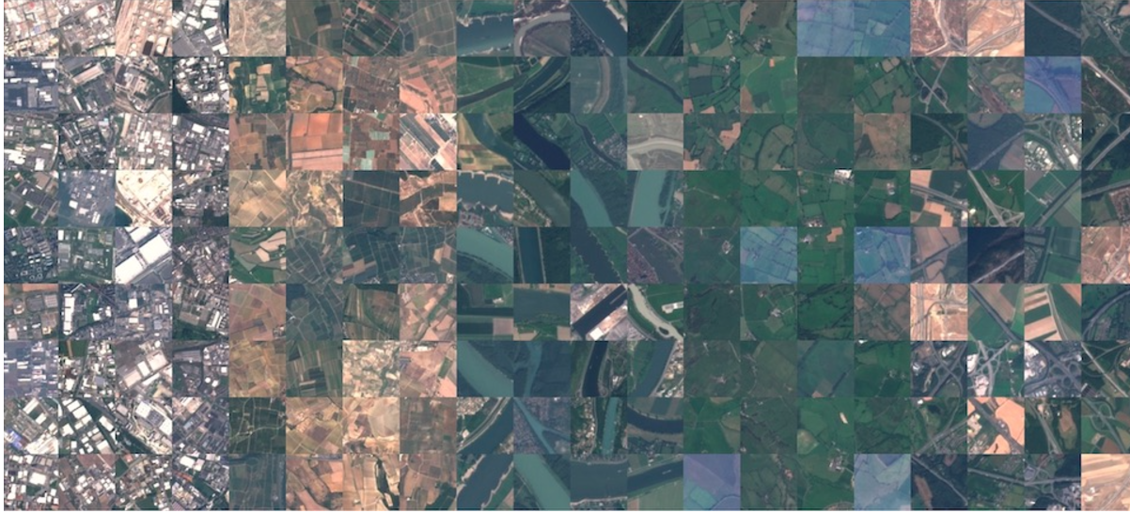
INTRODUCTION
Multi-spectral imaging is useful because it captures details beyond what we see with the naked eye. Standard images use Red (R), Green (G), and Blue (B), but in some cases, like low light or objects with similar colors, RGB alone is not enough. Adding a Near-Infrared (NIR) band helps improve contrast and edge detection. This is important for applications in remote sensing, agriculture, surveillance, security, and medical imaging.
However, combining RGB and NIR has challenges:
Redundant Information – Since RGB bands are already related, adding NIR without proper processing may not help.
Interference – RGB focuses on color, while NIR highlights edges. If not combined correctly, the model may get confused.
03

Slide 5
INTRODUCTION
Deep learning, especially Convolutional Neural Networks (CNNs), is an effective way to extract and learn features from RGB and NIR separately.
This project aims to develop a deep learning model that can classify RGB-NIR images more accurately than traditional methods.
A strong RGB-NIR classification model can benefit many fields: Remote sensing, agriculture, medical images.
For this project, we used ResNet and EfficientNet to process RGB and NIR separately and then combined their features for better classification. Our goal is to improve accuracy in scene recognition using deep learning, bridging the gap between traditional and multi-spectral classification methods.
04

Slide 6
LITERATURE REVIEW
Serial | Author | Dataset | Methodology
[1] | Jiang et al. | RGB-NIR Dataset | A double-channelCNN algo that considered the strong correlation between the R, G, and B and the weaker connection between NIR band and R, G, B bands.
[2] | Karuppannanet al. | RGB-NIR Dataset | A novel Spectral-Spatial Deep DenseNet framework for multispectral image classification and analysis, 2 which combined spectral and spatial information to enhance discriminative power and achieved su perior performance on benchmark datasets.
[3] | Peng et al. | RGB-NIR Dataset | A novel training methodology for incorporating prior knowledge into a deep architecture, allowing the omission of heavy labeling of large amounts of image data to address the big data requirements in deep learning.
05

Slide 7
DATASET COLLECTION AND PREPARATION
Primary Source:
About: The RGB-NIR Scene Dataset is a custom-collected dataset by the IVRL team using modified Nikon D90 and Canon T1i cameras.
Total Images: 477 paired RGB and NIR images.
Nine scene categories: Country, Field, Forest, Indoor, Mountain, Old building, Street, Urban, and Water.
Image Format: TIFF format at 1024×768 resolution.
06

Slide 8
DATASET COLLECTION AND PREPARATION
Online Availability:
Website: Publicly accessible through the IVRL-EPFL website.
Link: https://www.epfl.ch/labs/ivrl/research/downloads/rgb-nir-scene-dataset/
Created by: Introduced in 2011 in CVPR (International Conference on Computer Vision and Pattern Recognition) paper “Multispectral SIFT for Scene Category Recognition” by Brown and Süsstrunk.
Paper Reference: M. Brown and S. Süsstrunk, “Multispectral SIFT for scene category recognition,” in Proceedings of the IEEE Conference on Computer Vision and Pattern Recognition (CVPR), Colorado Springs, CO, USA, 2011, pp. 177-184, doi: 10.1109/CVPR.2011.5995635.
07

Slide 9
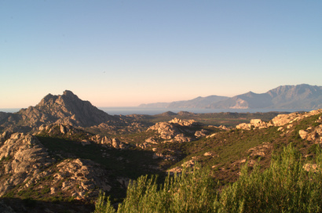
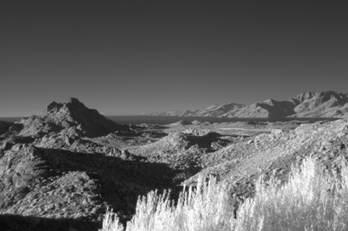
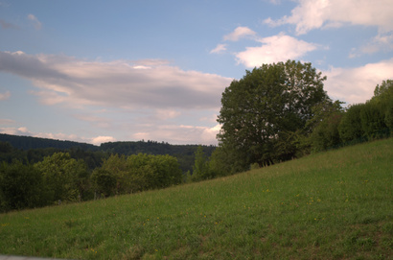
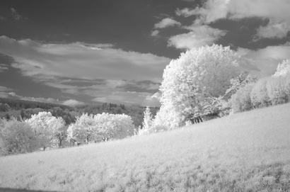
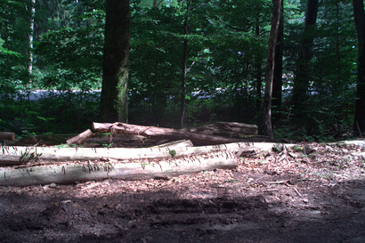
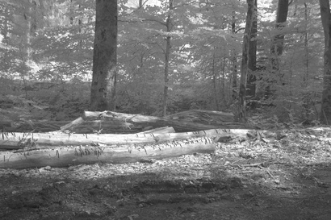
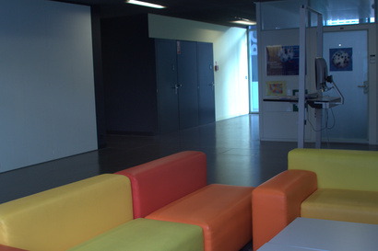
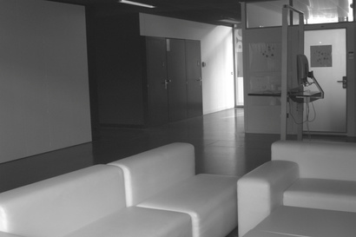
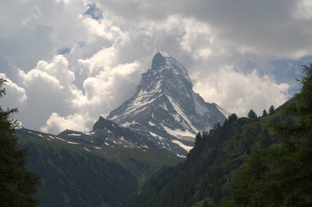
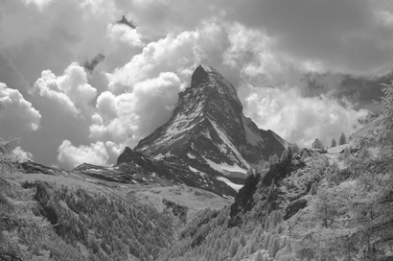
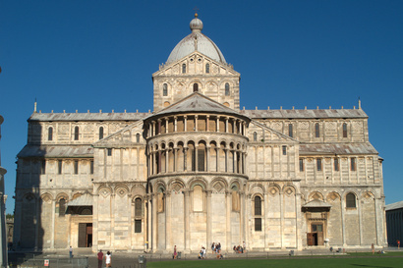
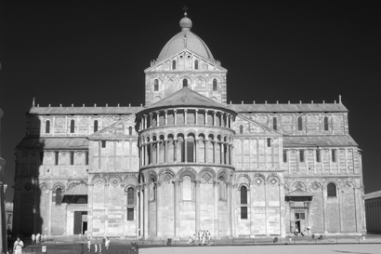
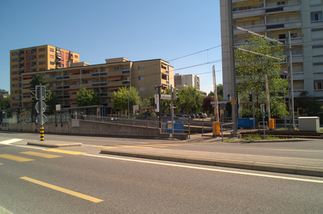
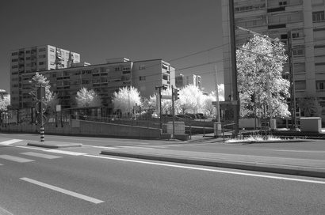
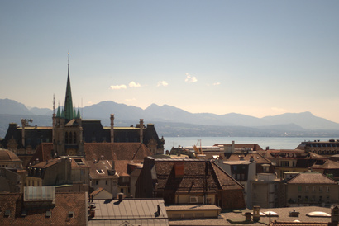
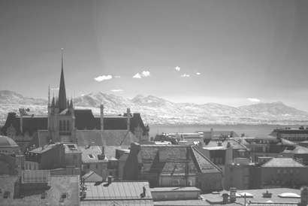
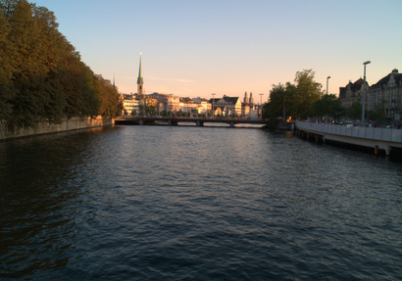
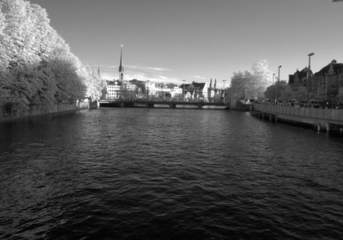
CLASSES
Country
Field
Forest
Indoor
Mountain
Old Building
Street
Urban
Water
08

Slide 10
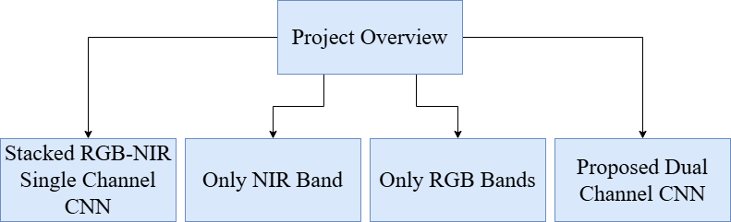
PROJECT PIPELINE
09

Slide 11
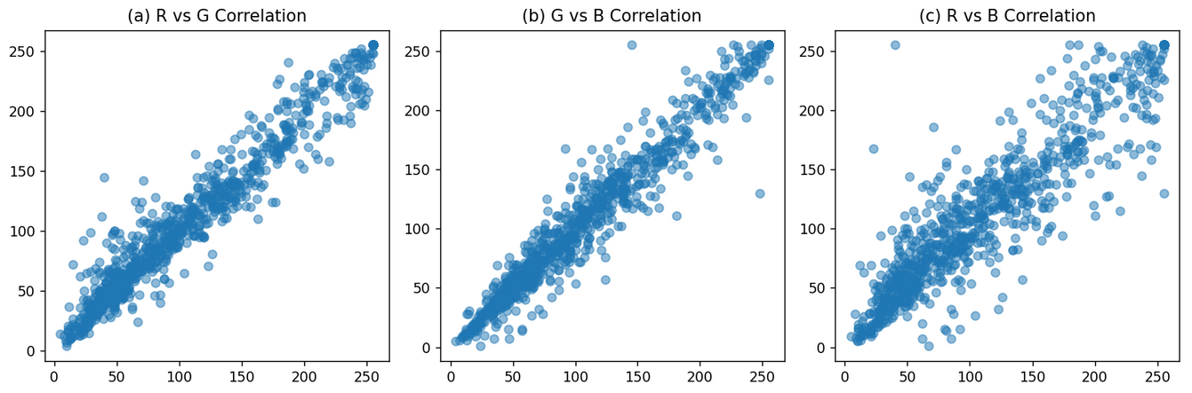
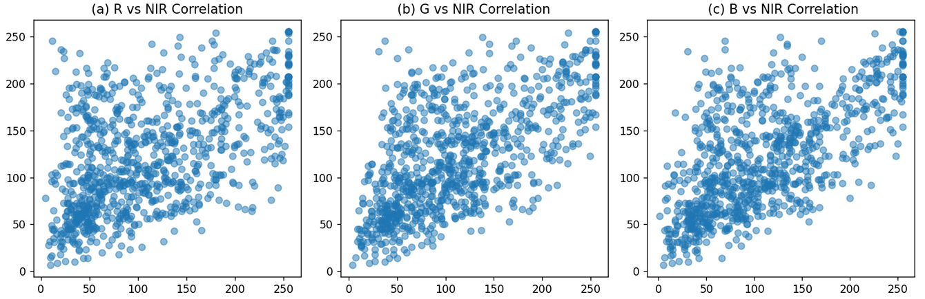
CHANNEL CORELATION
The correlation between NIR and R, G, and B bands is significantly lower than the correlation between the individual bands.
It is observed that most of the values in the R-G, R-B, and G-B relationships are concentrated.
The distributions of R-NIR, B-NIR, and G-NIR are quite scattered, and hence the correlation is very weak.
10

Slide 12
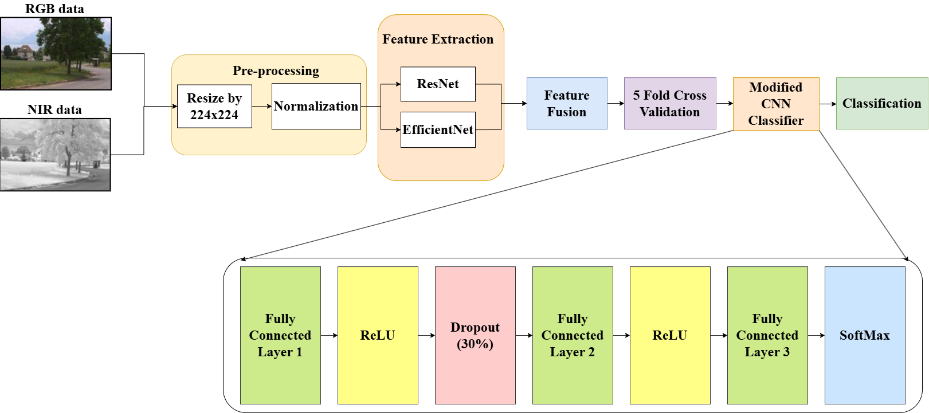
PROPOSED DUAL CHANNEL CNN
11

Slide 13
LIST OF MODELS WE HAVE ALREADY USED
Why ResNet18?
🔹 Deep Residual Learning: Avoids vanishing gradients.
🔹 Lightweight & Efficient: Faster training and inference.
🔹 Feature Extraction: Captures spatial and texture details.
🔹 Proven Performance: Popular in image classification.
Why EfficientNet?
🔹 Scaling Efficiency: Optimized depth, width, and resolution.
🔹 Higher Accuracy: Fewer parameters, better performance.
🔹 Better Generalization: Works well across different input types.
🔹 Energy Efficient: Requires fewer computations.
12

Slide 14
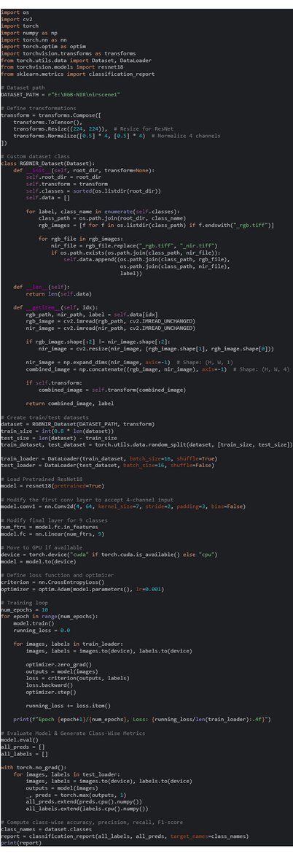
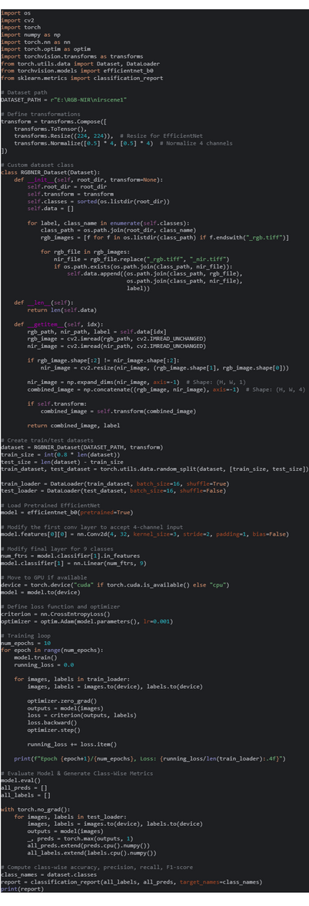
CODE SNIPENT
ResNet RGB NIR Stacked
EfficientNet RGB NIR Stacked
13

Slide 15
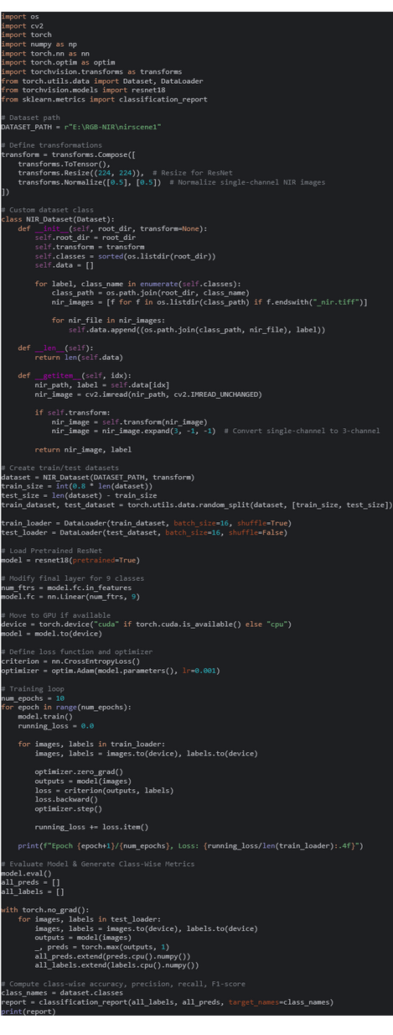
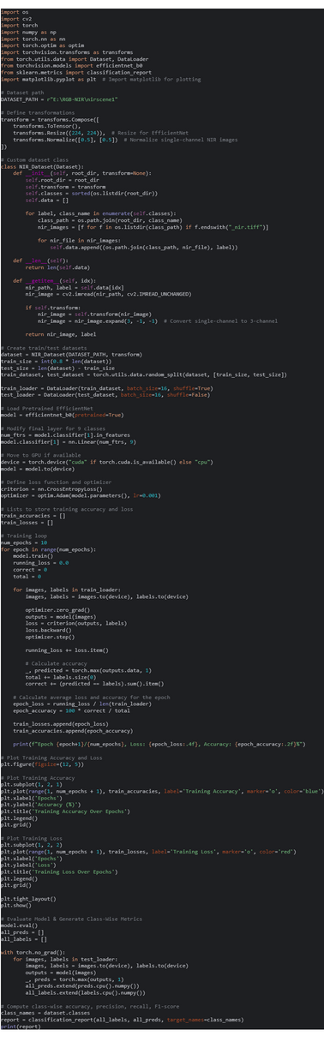
CODE SNIPENT
ResNet Only NIR
EfficientNet Only NIR
14

Slide 16
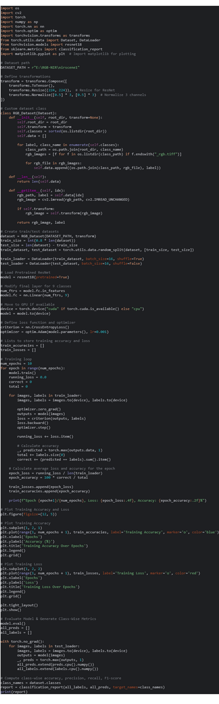
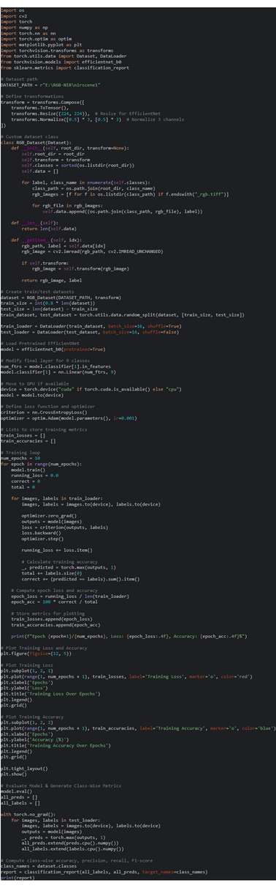
CODE SNIPENT
ResNet Only RGB
EfficientNet Only RGB
15

Slide 17
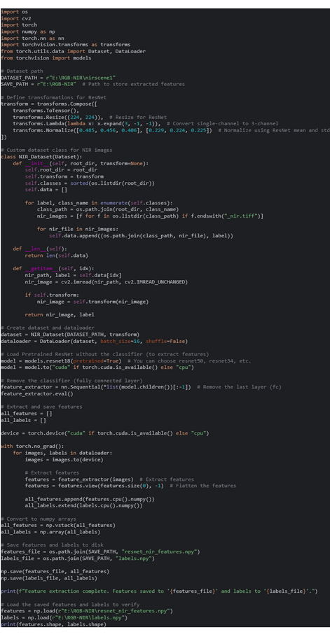
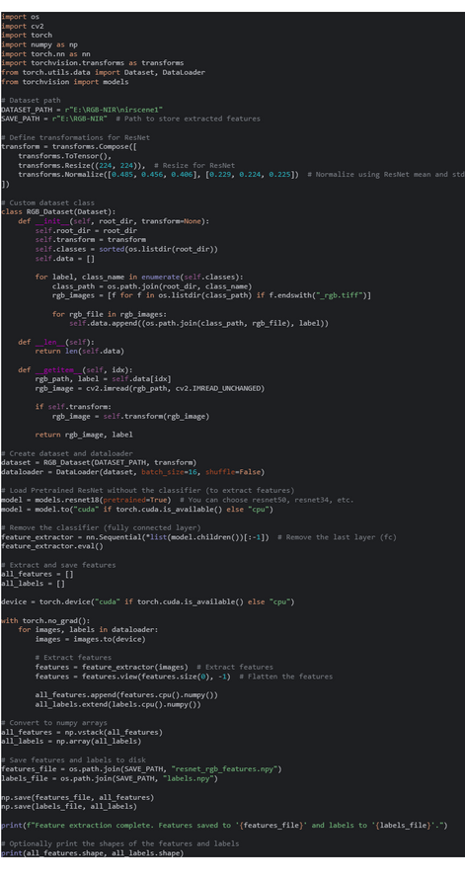
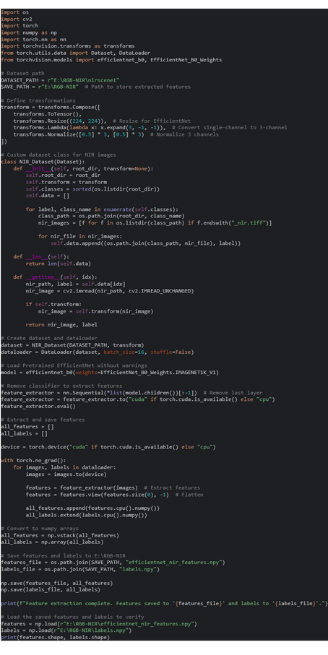
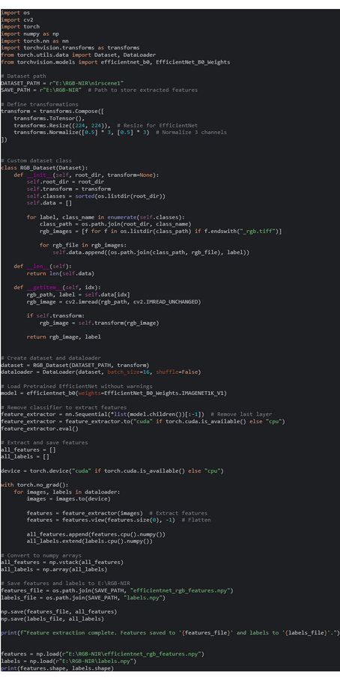
CODE SNIPENT
Proposed Dual Channel CNN
Feature Extraction ResNet
Feature Extraction EfficientNet
NIR
RGB
NIR
RGB
16

Slide 18
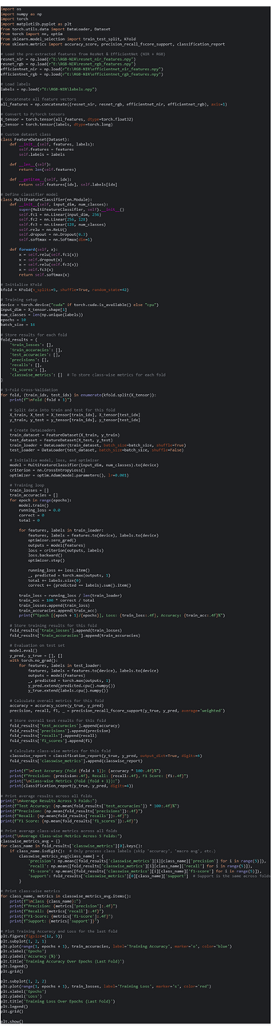
CODE SNIPENT
Proposed Dual Channel CNN
Classification
17

Slide 19
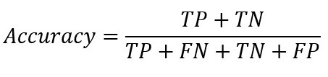
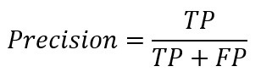
LIST OF PERFORMANCE METRICS
Accuracy
Measures overall correctness
Best for balanced datasets
Precision
Measures how many predicted positives are actually correct
Useful when avoiding false positives is important
18

Slide 20
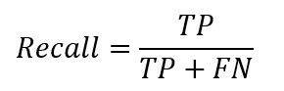
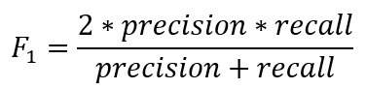
LIST OF PERFORMANCE METRICS
Recall
Measures how well the model finds all actual positives
Important when missing positives is a big problem
F1 Score
Balances Precision and Recall
Helpful when the data has more of one class than the other
19

Slide 21
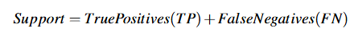
LIST OF PERFORMANCE METRICS
Support
Support represents the number of actual occurrences of each class in the dataset.
It is used to provide context for the other metrics
20

Slide 22
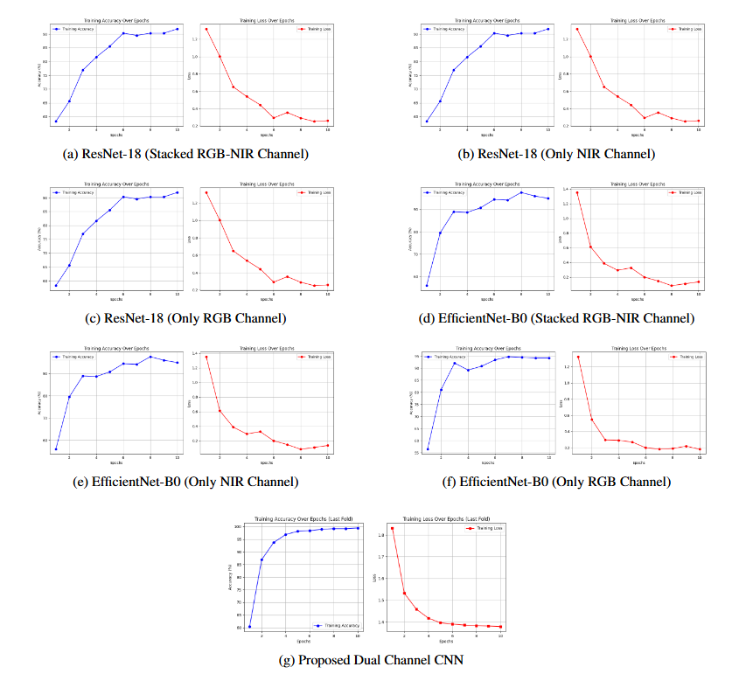
TRAINING
21

Slide 23
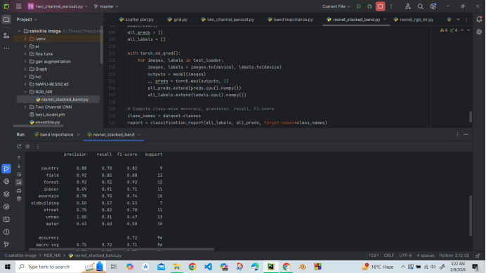
RESNET (RGB-NIR STACKED)
Overall Accuracy: 0.72
Classes | Precision | Recall | f1-score | Support
Country | 0.88 | 0.78 | 0.82 | 9
Field | 0.92 | 0.85 | 0.88 | 13
Forest | 0.92 | 0.92 | 0.92 | 12
Indoor | 0.59 | 0.91 | 0.71 | 11
Mountain | 0.78 | 0.70 | 0.74 | 10
Old-building | 0.50 | 0.57 | 0.53 | 7
Street | 0.75 | 0.82 | 0.78 | 11
Urban | 1.00 | 0.31 | 0.47 | 13
Water | 0.43 | 0.60 | 0.50 | 10
Overall Precision: 0.77
Overall Recall: 0.72
Overall F1-Score: 0.75
Overall Support: 96
Code Implementation:
22

Slide 24
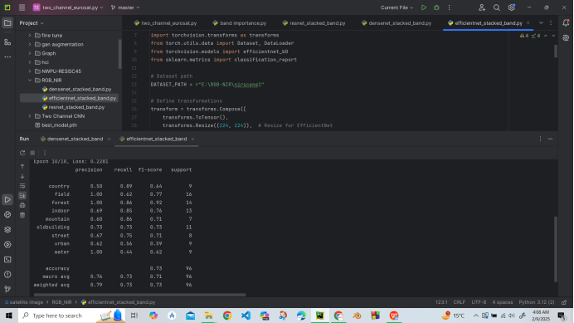
EFFICIENTNET (RGB-NIR STACKED)
Overall Accuracy: 0.73
Classes | Precision | Recall | f1-score | Support
Country | 0.50 | 0.89 | 0.64 | 9
Field | 1.00 | 0.62 | 0.77 | 16
Forest | 1.00 | 0.86 | 0.92 | 14
Indoor | 0.69 | 0.85 | 0.76 | 13
Mountain | 0.60 | 0.86 | 0.71 | 7
Old-building | 0.73 | 0.73 | 0.73 | 11
Street | 0.67 | 0.75 | 0.71 | 8
Urban | 0.62 | 0.56 | 0.59 | 9
Water | 1.00 | 0.44 | 0.62 | 9
Overall Precision: 0.79
Overall Recall: 0.73
Overall F1-Score: 0.73
Overall Support: 96
Code Implementation:
23

Slide 25
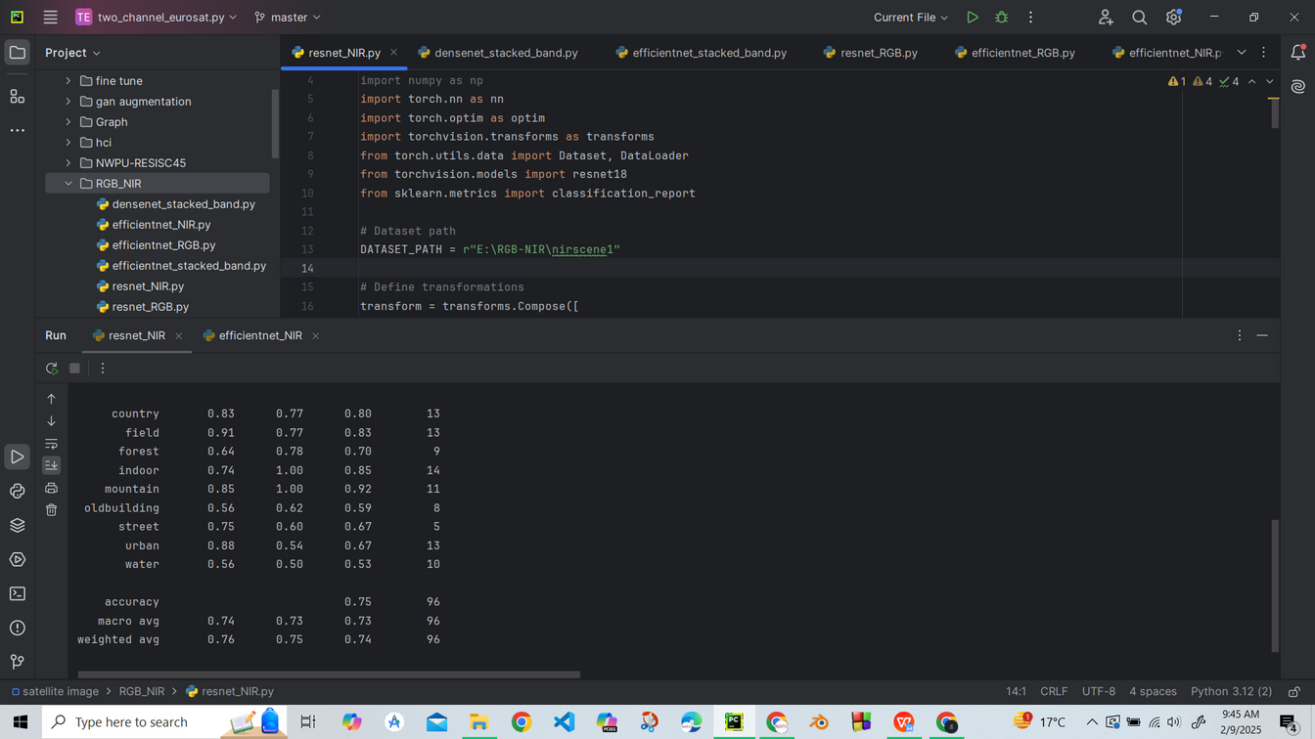
RESNET (ONLY NIR)
Classes | Precision | Recall | f1-score | Support
Country | 0.83 | 0.77 | 0.80 | 13
Field | 0.91 | 0.77 | 0.83 | 13
Forest | 0.64 | 0.78 | 0.70 | 9
Indoor | 0.74 | 1.00 | 0.85 | 14
Mountain | 0.85 | 1.00 | 0.92 | 11
Old-building | 0.56 | 0.62 | 0.59 | 8
Street | 0.75 | 0.60 | 0.67 | 5
Urban | 0.88 | 0.54 | 0.67 | 13
Water | 0.56 | 0.50 | 0.53 | 10
Overall Accuracy: 0.75
Overall Precision: 0.76
Overall Recall: 0.75
Overall F1-Score: 0.74
Overall Support: 96
Code Implementation:
24

Slide 26
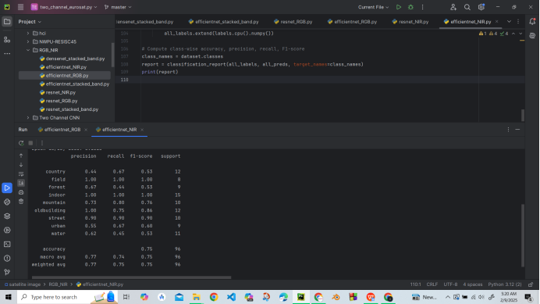
EFFICIENTNET (ONLY NIR)
Classes | Precision | Recall | f1-score | Support
Country | 0.44 | 0.67 | 0.53 | 12
Field | 1.00 | 1.00 | 1.00 | 8
Forest | 0.67 | 0.44 | 0.53 | 9
Indoor | 1.00 | 1.00 | 1.00 | 15
Mountain | 0.73 | 0.80 | 0.76 | 10
Old-building | 1.00 | 0.75 | 0.86 | 12
Street | 0.90 | 0.90 | 0.90 | 10
Urban | 0.55 | 0.67 | 0.60 | 9
Water | 0.62 | 0.45 | 0.53 | 11
Overall Accuracy: 0.75
Overall Recall: 0.77
Overall Precision: 0.75
Overall F1-Score: 0.75
Overall Support: 96
Code Implementation:
25

Slide 27
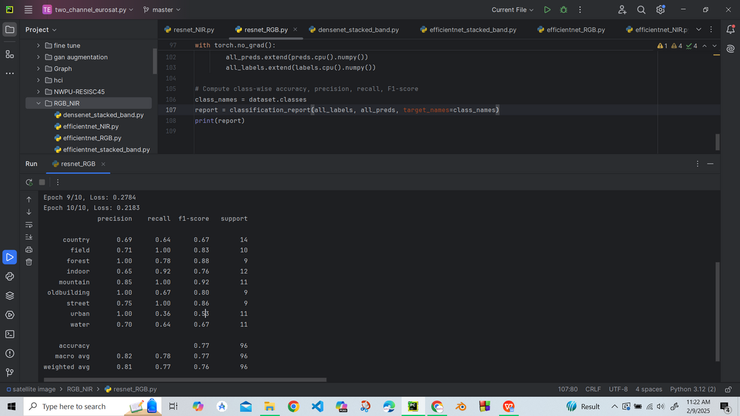
RESNET (ONLY RGB)
Classes | Precision | Recall | f1-score | Support
Country | 0.69 | 0.64 | 0.67 | 14
Field | 0.71 | 1.00 | 0.83 | 10
Forest | 1.00 | 0.78 | 0.88 | 9
Indoor | 0.65 | 0.92 | 0.76 | 12
Mountain | 0.85 | 1.00 | 0.92 | 11
Old-building | 1.00 | 0.67 | 0.80 | 9
Street | 0.75 | 1.00 | 0.86 | 9
Urban | 1.00 | 0.36 | 0.53 | 11
Water | 0.70 | 0.64 | 0.67 | 11
Overall Accuracy: 0.77
Overall Precision: 0.81
Overall Recall: 0.77
Overall F1-Score: 0.76
Overall Support: 96
Code Implementation:
26

Slide 28
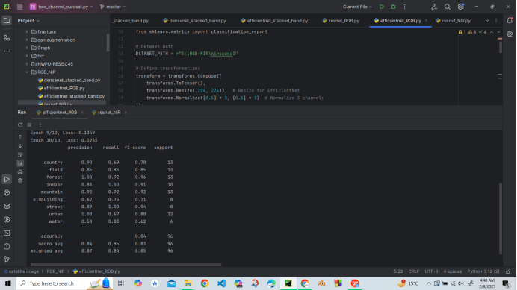
EFFICIENTNET (ONLY RGB)
Classes | Precision | Recall | f1-score | Support
Country | 0.90 | 0.69 | 0.78 | 13
Field | 0.85 | 0.85 | 0.85 | 13
Forest | 1.00 | 0.92 | 0.96 | 13
Indoor | 0.83 | 1.00 | 0.91 | 10
Mountain | 0.92 | 0.92 | 0.92 | 13
Old-building | 0.67 | 0.75 | 0.71 | 8
Street | 0.89 | 1.00 | 0.94 | 8
Urban | 1.00 | 0.67 | 0.80 | 12
Water | 0.50 | 0.83 | 0.62 | 6
Overall Accuracy: 0.84
Overall Precision: 0.87
Overall Recall: 0.84
Overall F1-Score: 0.85
Overall Support: 96
Code Implementation:
27

Slide 29
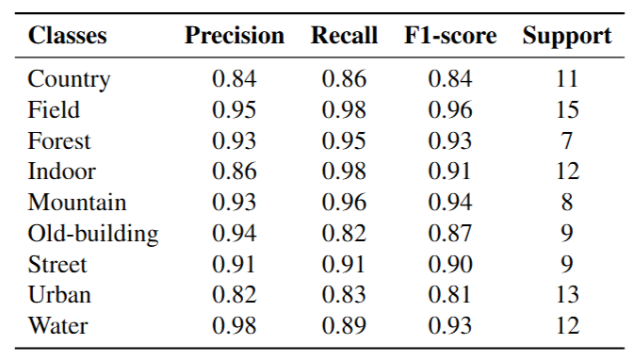
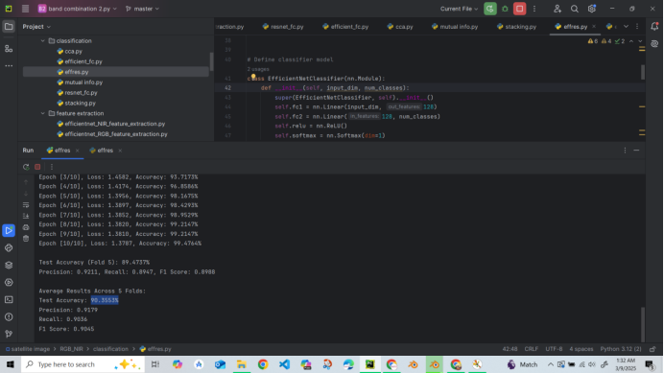
PROPOSED DUAL CHANNEL CNN
Average Results Across 5 Folds:
Test Accuracy: 90.5658%
Precision: 0.9155
Recall: 0.9057
F1 Score: 0.9047
Code Implementation:
28

Slide 30
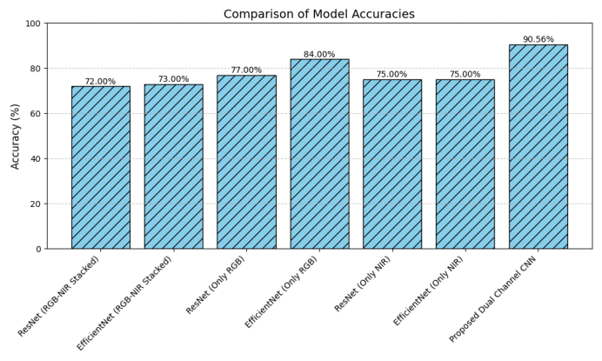
COMPARISON
29

Slide 31
REFERENCES
[1] J. Jiang, F. Liu, Y. Xu, H. Huang et al., “Multi-spectral rgb-nir image classification using double channel cnn,” IEEE Access, vol. 7, pp. 20607–20613, 2019.
[2] A.Karuppannan, K.S.Reddy, N.M.Patil, andC.M.V.S.Akana, “Spectral-spatial deep densenet learning for multispectral image classification and analysis.” ICTACT Journal on Image & Video Processing, vol. 14, no. 1, 2023.
[3] X. Peng, Y. Li, X. Wei, J. Luo, and Y. L. Murphey, “Rgb-nir image categorization with prior knowledge transfer,” EURASIP Journal on Image and Video Processing, vol. 2018, pp. 1–11, 2018.
30

Slide 32

THANK
YOU

